Slide 1
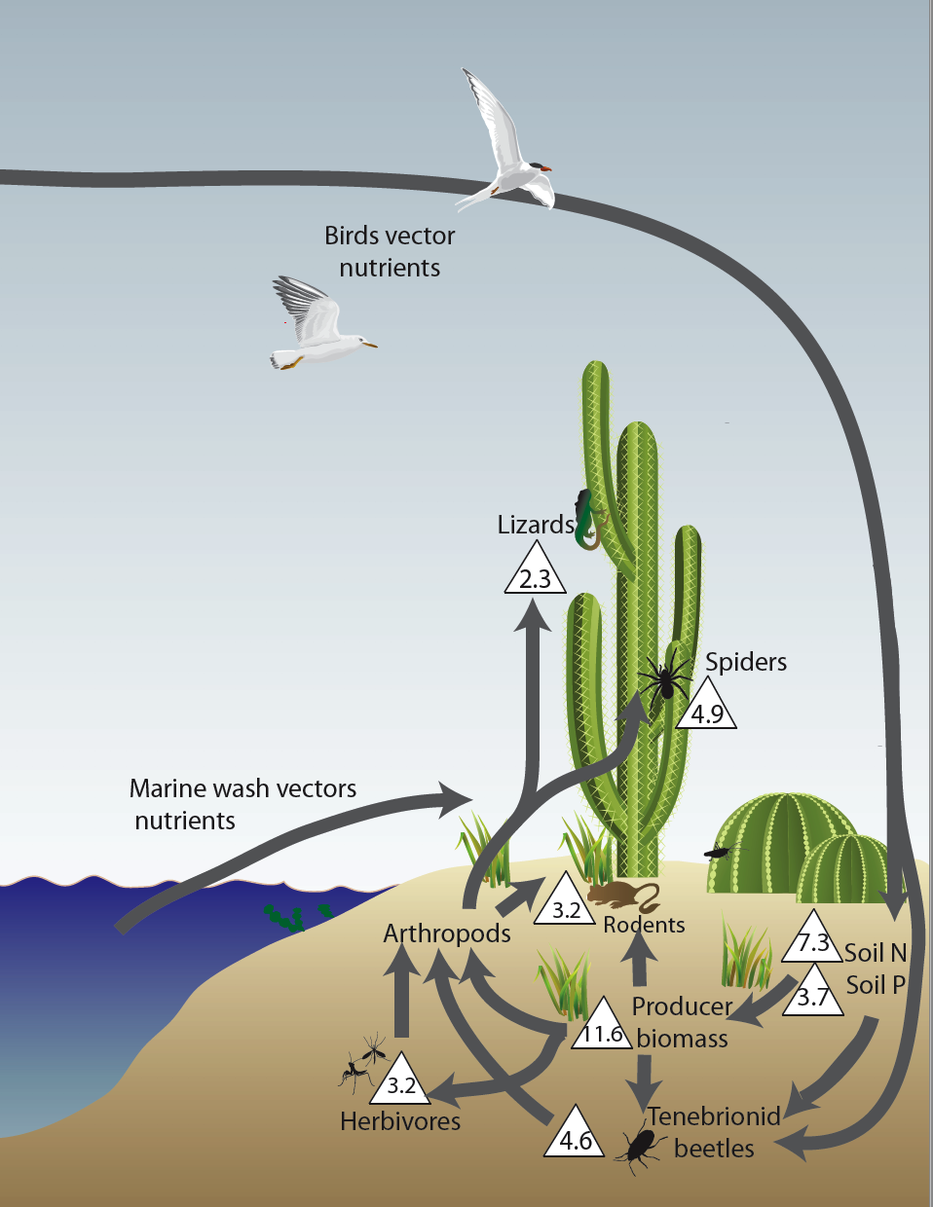
Work in Baja California transformed has shown that marine nutrients transform island ecosystems, causing increases in soil nutrients, plant abundance, and abundance of higher level consumers. Numbers in triangles indicate the increase in abundance of consumers in subsidized vs unsubsidized consumers (e.g. lizards are 2.3 times more common on subsidized islands). This formative work transformed our understanding of the importance of aquatic subsidies to terrestrial communities and has many parallels to local systems.

Slide 2
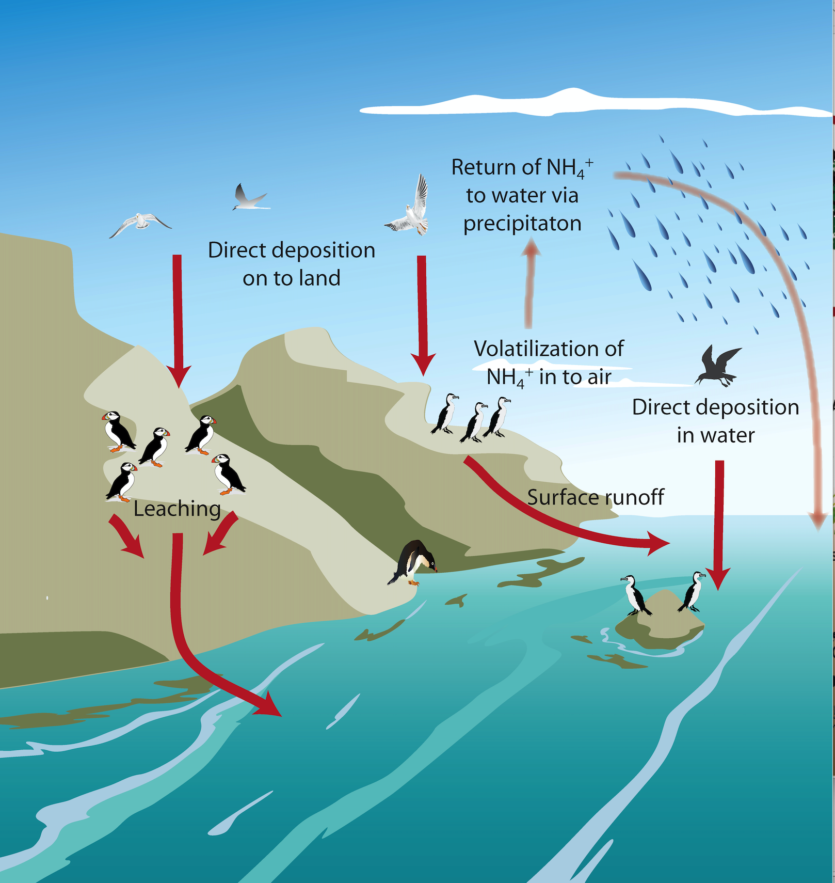
While we focus here on marine to terrestrial subsidies, it is important to recognize that this connectivity is circular. For instance, with seabirds, one of the most well established vectors of nutrients from land to sea, their nutrients also cycle back to aquatic ecosystems, often playing critical roles in supporting nearshore communities and fisheries, particularly in shallow water ecosystems (e.g. in this system, the terrestrial subsidies may indirectly support ntertidal or kelp forest communities)

Slide 3
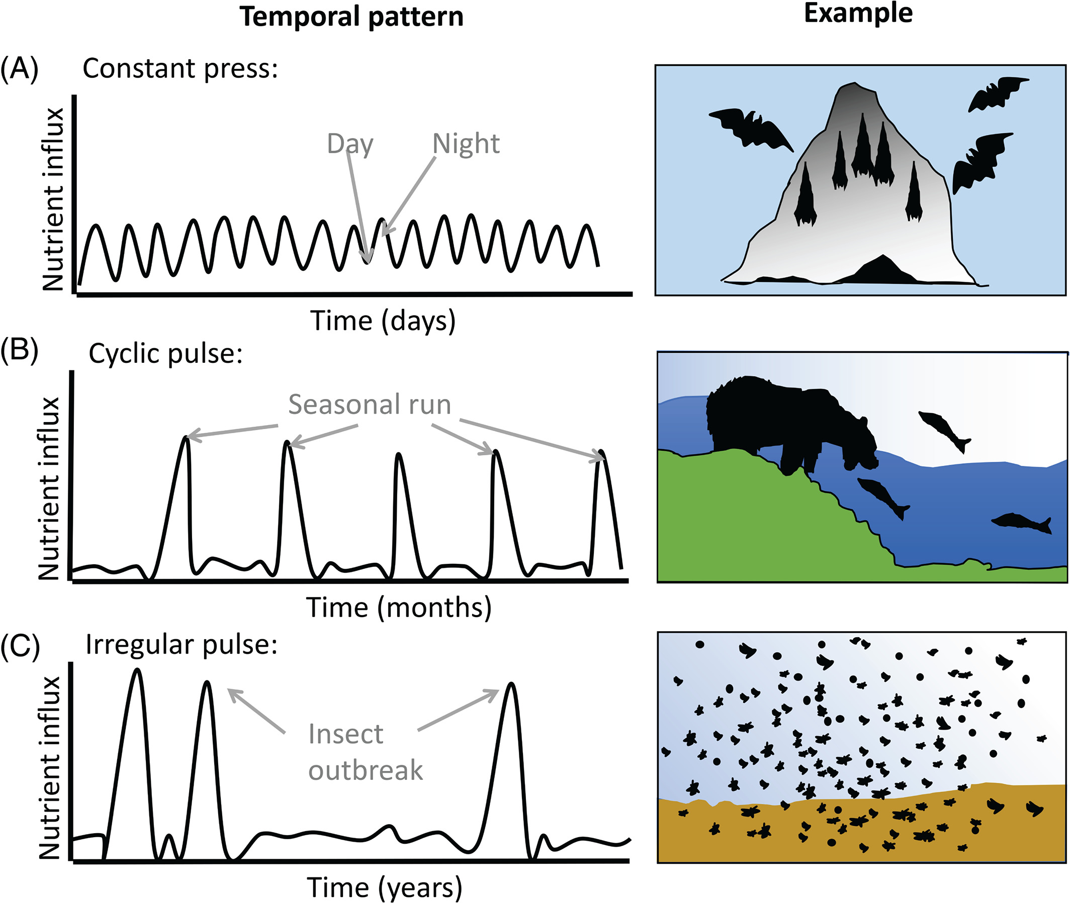
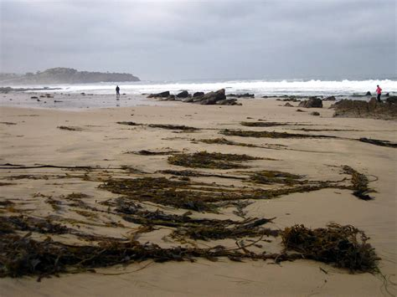
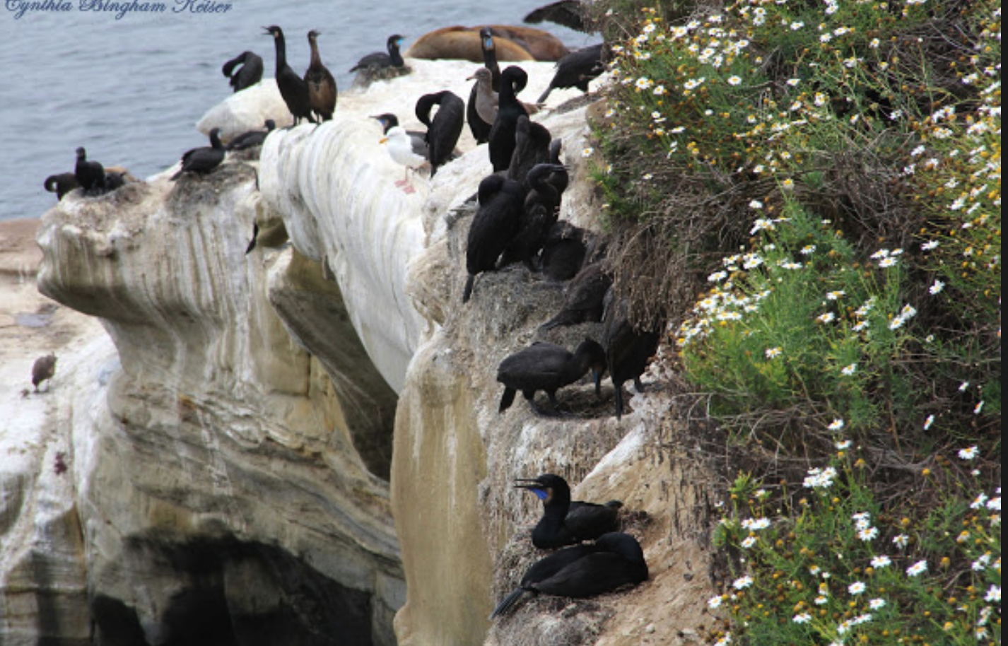
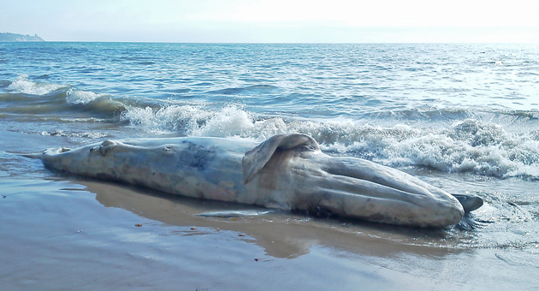
Tidal cycle
Annual nesting
Stranding or washup events
Nutrient subsidies can be delivered at a relatively constant (press) level, such as regular high tide delivery of marine wrack (A). They can come in cyclical pulses, such as regular nesting seasons of seabirds (B) or they can be delivered irregularly such as via intermittent carcass wash up or el-nino storm events (C). Figure modified from McInturf et al 2019.
Notes:
Variation in temporal dynamics of nutrient influx by active subsidies. (A) Constant press: bats provide relatively constant subsidies (with a daily cycle). These subsidies support a community of guano‐dependent consumers and their predators. (B) Cyclic pulse: migrating salmon provide strong pulses of nutrients with an accurate yearly cycle. These pulses support upstream consumers and facilitate aggregations of generally solitary bears. (C) Irregular pulse: locust migrations provide massive but non‐cyclic active subsidies that support communities in arid areas.
IF THIS IMAGE HAS BEEN PROVIDED BY OR IS OWNED BY A THIRD PARTY, AS INDICATED IN THE CAPTION LINE, THEN FURTHER PERMISSION MAY BE NEEDED BEFORE ANY FURTHER USE. PLEASE CONTACT WILEY'S PERMISSIONS DEPARTMENT ON PERMISSIONS@WILEY.COM OR USE THE RIGHTSLINK SERVICE BY CLICKING ON THE 'REQUEST PERMISSIONS' LINK ACCOMPANYING THIS ARTICLE. WILEY OR AUTHOR OWNED IMAGES MAY BE USED FOR NON-COMMERCIAL PURPOSES, SUBJECT TO PROPER CITATION OF THE ARTICLE, AUTHOR, AND PUBLISHER.

Slide 4
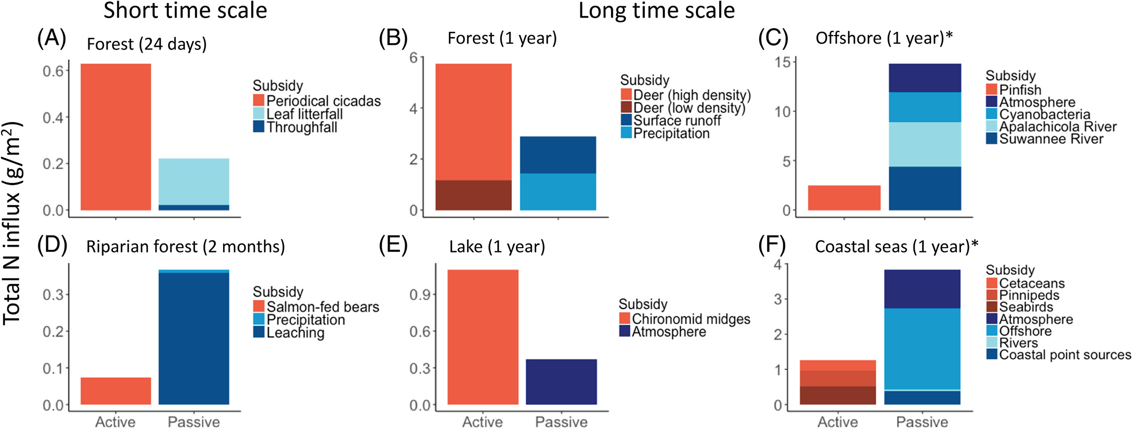
The amount of nutrients delivered from spatial subsidies can vary by orders of magnitude across ecosystems. Additionally the relative importance of active (red) subsidies vs passive (blue) subsidies varies dramatically by ecosystem. As of yet we lack a systematic framework to accurately estimate the relative importance of either active or passive subsidies in an ecosystem without actually measuring them.
Notes:
A quantitative comparison of net nitrogen influx by active (red) and passive (blue) subsidy sources in different ecosystems at various time scales. Active subsidies can generate pulses of events at shorter time scales: (A) in forest ecosystems, over the course of 24 days (Hamburg & Lin, ; Whiles et al., ) and (B) in riparian forest ecosystems, over the course of 2 months (Helfield & Naiman, ). Similarly, they can create a prolonged impact over the course of an entire year: (C) in forest ecosystems (Peterjohn & Correll, ; Seagle, ); (D) along the aquatic–terrestrial interface in lake systems (Yang & Gratton, ; Dreyer et al., ); (E) in offshore regions (Nelson et al., ); and (F) in coastal marine ecosystems (Townsend, ; Sowles, ; Roman & McCarthy, ). In cases where a range of nitrogen‐deposition values are available, we have included the most conservative estimates. Asterisks indicate log‐transformed values.
IF THIS IMAGE HAS BEEN PROVIDED BY OR IS OWNED BY A THIRD PARTY, AS INDICATED IN THE CAPTION LINE, THEN FURTHER PERMISSION MAY BE NEEDED BEFORE ANY FURTHER USE. PLEASE CONTACT WILEY'S PERMISSIONS DEPARTMENT ON PERMISSIONS@WILEY.COM OR USE THE RIGHTSLINK SERVICE BY CLICKING ON THE 'REQUEST PERMISSIONS' LINK ACCOMPANYING THIS ARTICLE. WILEY OR AUTHOR OWNED IMAGES MAY BE USED FOR NON-COMMERCIAL PURPOSES, SUBJECT TO PROPER CITATION OF THE ARTICLE, AUTHOR, AND PUBLISHER.

Slide 5
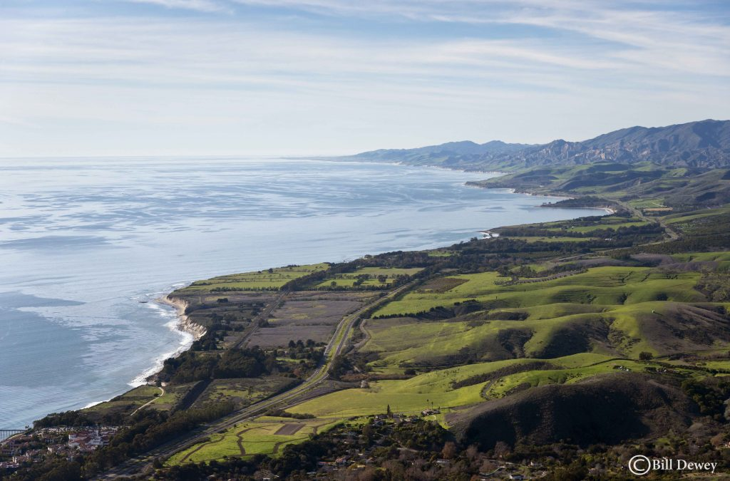
A
B
C
Physical, abiotic processes such as upwellings and waves may create an underlying nutrient gradient in a landscape (A). Animals may then transfer nutrients directionally, including against natural physical gradients (e.g. animals transferring nutrients upland into the interior (B). Secondary consumption may further distribute these nutrients, often creating spatial heterogeneity in distribution of subsidized nutrients (e.g. animals moving nutrients to dens, along riverways) (C).

